Slide 1
Eungella Pioneer-Burdekin PHES Proposal: Assessment Process
Patricia Julien
18th September 2024

Slide 2
Eungella’s 5GW PHES (18-24 hour backup firming storage, and at least 1,000 MW of generation capacity) It would be the beginning of large-scale projects to support high electrification projects & critical minerals infrastructure.
Around 25GW of large-scale renewable generation is required to meet forecast electricity energy demand in 2035.
Further developments will occur across all regions (of mainly coastal Queensland) to progressively unlock additional capacity.
There are numerous smaller capacity and shorter duration (4-12 hours) pumped hydro projects being developed by the private sector which are expected to form an important role in firming renewable generation. e.g. Capricornia Energy Hub (0.75GW) on Broken River.
Queensland will need at least 6GW of long duration storage1 for a highly renewable system.
Https://www.epw.qld.gov.au/__data/assets/pdf_file/0030/32988/queensland-supergrid-infrastructure-blueprint.pdf
A Gigawatt is 1,000,000,000 watts

Slide 3
Large-scale PHES such as Pioneer-Burdekin PHES
A PHES needs a source of water, and two reservoirs separated by a significant change in elevation (known as head). A larger head will generally provide for lower cost electricity generation and storage on a per-unit basis as the volume of water required per megawatt hour is lower.
These projects have:
  long lead times (8 to 10 years),
  greater approval complexity and uncertainty, and
  a high development and capital cost.

Slide 4
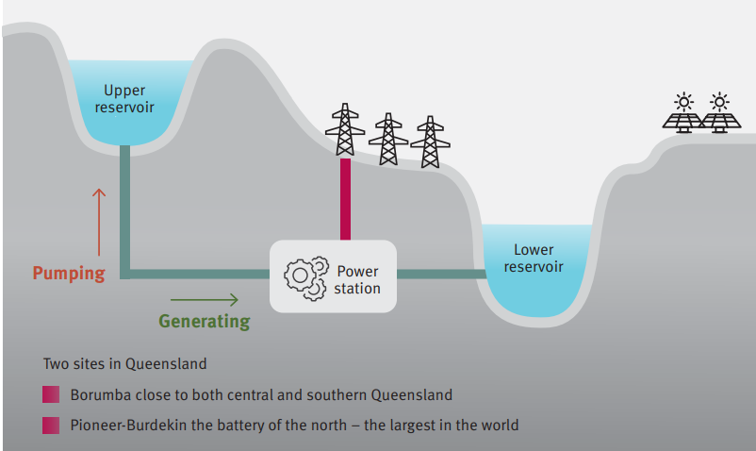

Slide 5
Transmission Line from Eungella to the state power grid.
a 750km line to connect central Queensland to a north Queensland 24-hour PHES and north Queensland load
Route is as yet not available from Powerlink.

Slide 6
Why pick Eungella for a pumped hydro project?
One of the few sites in Queensland outside a national park high enough in elevation to produce a huge 5GW pumped hydro electricity storage for up to 18-24 hours to meet electricity demand if solar and wind power are unavailable. (Australian Electricity Market Organization)
But it is only suitable if it also meets the Queensland Treasury Act requirements to be a large-scale sustainable development.
  Socially (Social Impact Assessment)
  Environmentally (Environmental Impact Assessment) &
  Economically (Positive cost/benefit Assessment) sustainable

Slide 7
Pumped Hydro Atlas of Australia
Entura’s Pumped Hydro Atlas of Australia takes into account far more than the basics of identifying ideal topography and a source of water. It also accounts for other practical factors that can make or break a project: such as
proximity to and location within the transmission network,
land-use constraints and environmental risks, and
the practicalities and costs of construction and ongoing operation.

Slide 8
Eungella would be the test case for very large-scale PHES development in Queensland.
What stage is the development assessment at?
It has yet to begin as no reports on its viability have yet been presented and will not be until the release of the DAR after Christmas.
The Detailed Analytical Report (DAR) involves on ground research of the site’s suitability and will inform the government if the project should proceed to the EIS development assessment stage i.e.
  Drilling studies for the tunnels
  Hydrology modeling
  Environmental surveys
  Community impacts
  Costs estimates

Slide 9
Right of Access to Properties
In Queensland a company can apply to the state government for permission to access a property to undertake preliminary testing for a development they are considering.
But the landowner has the right to determine where investigations can occur i.e. where they will not cause harm.
The landowner and state government also require that no invasive species including weeds, are brought in via any investigation processes e.g. regular use of washdown facilities prior to entry.
The company wanting access must abide by the state permit conditions as well as the landowner conditions where they may cause harm.

Slide 10

Role of the Australian government
If the project will or is likely to adversely impact Matters of National Environmental Significance (MNES) an EPBC Referral to the department of Climate Change, Energy and Water (DCCEW) is required. EPBC is the national Environmental Protection and Biodiversity Conservation Act.
The community has the right to make comments on any Referral and add information missing from the development proponent’s Referral.
If the impacts are significant and cannot be mitigated, remediated or offset the project can be refused. Refusal is extremely rare.
Usually, the Australian Environment Minister sets conditions to remove or reduce adverse impacts on any MNES.

Slide 11
IMPORTANT: EPBC Referrals
(You have 20 business days to comment)
******************************************
The community has the right to review and provide information/data on any EPBC Referral by QldHydro especially if information on impacts and their severity on MNES are missed. MNES can be found in a Protected Matters Search of the DCCEW website.
QldHydro must respond to the Department and address any issues the Department requests.
Ecologist Sybelle Foxcroft will provide a list of MSES species and short-range endemic species found nowhere else but in the development impact areas.
Appoint one or two community members to review every two days the EPBC Referral website to see if QldHydro has made a Referral. This is likely if and as soon as the Labor is re-elected and after the DAR is released around Christmas. But it is recommended that you begin to monitor it starting now.
EPBC Referrals at https://epbcpublicportal.awe.gov.au/all-referrals/
Ask us for help if needed to know what to search for. Recommend the term “QldHydro”

Slide 12
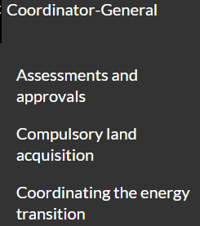
Environmental Impact Assessment Process
If the Queensland government decides to proceed the next stage (they say after the DAR is released around Christmas) is the preparation of an EIS overseen by the Queensland Department of State Development with the final decision by the Coordinator-General of this department.
Check https://www.statedevelopment.qld.gov.au/coordinator-general/assessments-and-approvals
The DSD coordinates input from various departments to prepare the draft Terms of Reference for the development and assess subsequent information provided by the project’s proponent. The C-G can ask for further information as the assessment proceeds.

Slide 13
Compulsory Land Acquisition by the DSD
Landowners who are approached for compulsory land acquisition are advised to seek legal advice from an experienced professional.
We may be able to assist in finding such experts. Lock The Gate also could be asked who they recommend to landowners approached by mining companies.
Landowners have the right to place an Objection to the Queensland Land Court if they oppose the acquisition, especially if they can show that the offered compensation is inadequate. Affected landowners may join together to do this.

Slide 14
https://www.statedevelopment.qld.gov.au/coordinator-general/assessments-and-approvals

Slide 15
The community has the right to review and make comments and provide information/data on the Draft Terms of Reference especially if information on impacts and their severity are missed.
Cover social, environmental and economic impacts.
By this time you should have started to prepare a Social Impacts Assessment with the help of a Social Impacts Assessment professional expert. Check online and we may be able to recommend a person.
There is a good SIA guide available at https://www.statedevelopment.qld.gov.au/__data/assets/pdf_file/0017/17405/social-impact-assessment-guideline.pdf
Also include in the draft ToR likely or expected Matters of State Environmental Significance (MSES). QldHydro must respond and address any issues raised that they have not covered in as much detail as possible.

Slide 16
Environmental Impacts on MNES & MSES
These will occur within the proposed development area including part of the biodiversity buffer zone for Eungella National Park, as well as within Eungella National Park (a national Protected Area), and possibly farther downstream in and along Broken River.
Many of the species found within Eungella National Park have also been found by ecologist Sybelle Foxcroft and local community land-owners and other volunteers in on ground surveys within the proposed project’s footprint.
The Clarke Range is also a climate change refugia area at least since the peak of the last Ice Age 40 million years ago. It must remain so, and that excludes large scale industrial development.

Slide 17
The principal purpose, most important function for human and planetary survival, and cardinal legal principle for protected areas is that they are there to conserve biological diversity and ecosystem services.
IN AUSTRALIA THIS IS THE
NATIONAL RESERVE SYSTEM OF PROTECTED AREAS
Queensland Nature Conservation Act
https://www.legislation.qld.gov.au/view/pdf/inforce/current/act-1992-020

Slide 18
The principal purpose, most important function for human and planetary survival, and cardinal legal principle for protected areas is that they are there to conserve biological diversity and ecosystem services. (International Treaty: Conservation of Biological Diversity)
In Australia this is the
NATIONAL RESERVE SYSTEM OF PROTECTED AREAS
Eungella National Park and its adjacent biodiversity protection zone is a Protected Area.

Slide 19
That includes their biodiversity buffer zones – 300m wide around Eungella National Park. The Pioneer-Pumped Hydro reservoirs would intrude into that buffer zone and would adversely impact the values for which Eungella National Park was declared a Protected Area.
There will also be adverse downstream impacts on the Massey Creek section of the nationally significant Broken River, Urannah Creek and Massey Creek Wetland Aggregation.

Slide 20
Queensland Regional Biodiversity Connectivity Corridors, which are also identified through Biodiversity Planning Assessments (BPAs), are displayed on the regional biodiversity network map. All of the Pioneer-Burdekin PHES is within a regional biodiversity corridor.
These connectivity corridors aim to:
identify and protect terrestrial and aquatic ecological and evolutionary processes at a landscape scale
maximize connectivity between large tracts of remnant vegetation
identify key areas for rehabilitation and offsets.

Slide 21
Applicable Biodiversity Biodiversity Assessment and Mapping Methodology (BAMM) criteria – part of the BPA. In Eungella:
Unique landscape features
Landscape areas containing distinct, unique or special features of hydrologic, geomorphic, or ecologic significance should be protected given their contribution to landscape variability and important habitat niches for a number of species.
Distinct, unique or special terrestrial features of hydrologic, geomorphic, or ecologic significance.
BAMM Criteria IG (Areas containing regional ecosystems with distinct variation in taxa composition) identifies areas containing ecosystems with distinct variation in taxa composition associated with geomorphology and other environmental variables.

Slide 22
It is possible that QldHydro is buying properties not only for the reservoirs but also to use what is not inundated to use them as biodiversity offsets to meet development requirements to compensate for adverse impacts that cannot be avoided or mitigated. How will that land be used?
If Labor does not win the election the LNP has stated it will not build the Pioneer-Burdekin pumped hydro project. How will they use the land that has been purchased for this project with taxpayer dollars?

Slide 23
Economic assessment
It is too soon to tell but assessment of the cost has doubled since the Queensland government announced the project.
We advise the community to engage an experienced economist if the Labor government is elected in October, and it announces after the DAR is released around Christmas, that the project will proceed to the EIS Assessment Stage.
As the project could last for 100 years it is highly likely that new technology to produce energy under all weather conditions could emerge and not involve destruction of places of high environmental values. All eggs in one or two massive expensive baskets may prove too risky a decision when all alternatives are fully considered, given the increasing variability in our region’s weather as climate change proceeds.
Also, at this time we still lack up to date regional plans, and water resource plans that could help guide such an important decision about firming energy sources. Batteries can now store power for up to 8 hours and continue to improve and its number of projects will outgrow those of pumped hydro by 2025. The future is not in large scale pumped hydro.

Slide 24
If the Coordinator-General approves this project the community has the right to request a Statement of Reasons for that decision. They can then review the decision with legal counsel and decide whether or not they have grounds to object that decision in the Queensland Land Court . Usually both parties pay their own costs unless there are extenuating circumstances. The decision of the Land Court can also be appealed in the Queensland Supreme Court if the parties find an error or errors in the decision.

